Slide 1

Software Technology Project
Final Presentation
Gruppe 9

Slide 2
FeedApp that became
Overview of key technologies
Brief Frontend (with demo)
Swagger Exposing the API
Overview of the backend in Spring
Docker for dev and deployment

Slide 3



Front-End
React:
Reason for choosing; what do we wanna learn for front end, React and it became React.
React Router: Used to enable URL navigation between components
React Redux: Central store of states, used for easy access to states between components
Demo

Slide 4
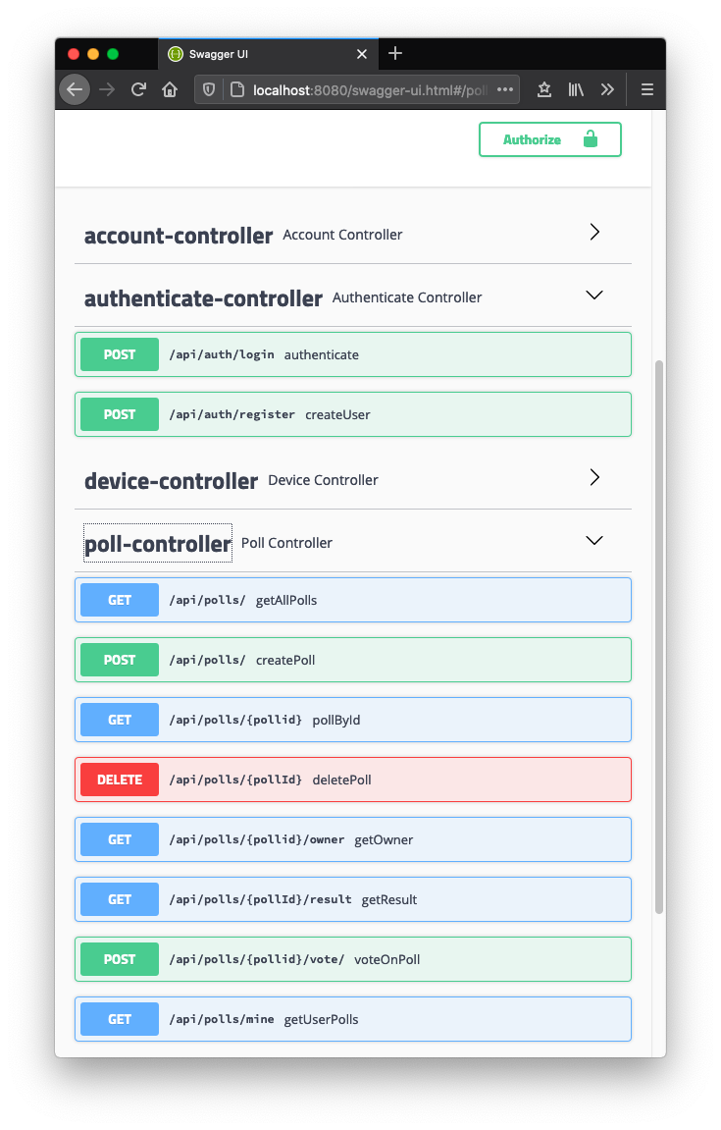
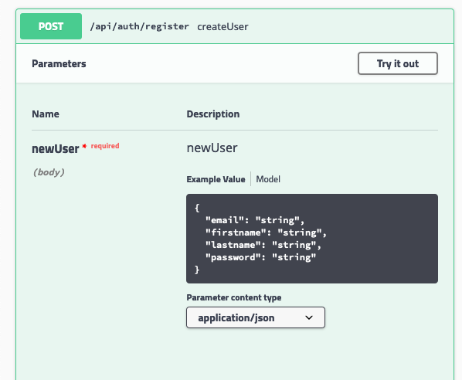
Swagger Exposing the API
Swagger did the following for us:
Overview of REST controller actions
Testing and verifying
Bug tracing

Slide 5



Overview of the backend in Spring
Spring framework is the core of our API
Made it easy to replace the database. (e.g Derby => MySQL or any other)
Also made it easy to incorporate new services in the API e.g RabbitMQ.
Securing the API with Spring Security.

Slide 6
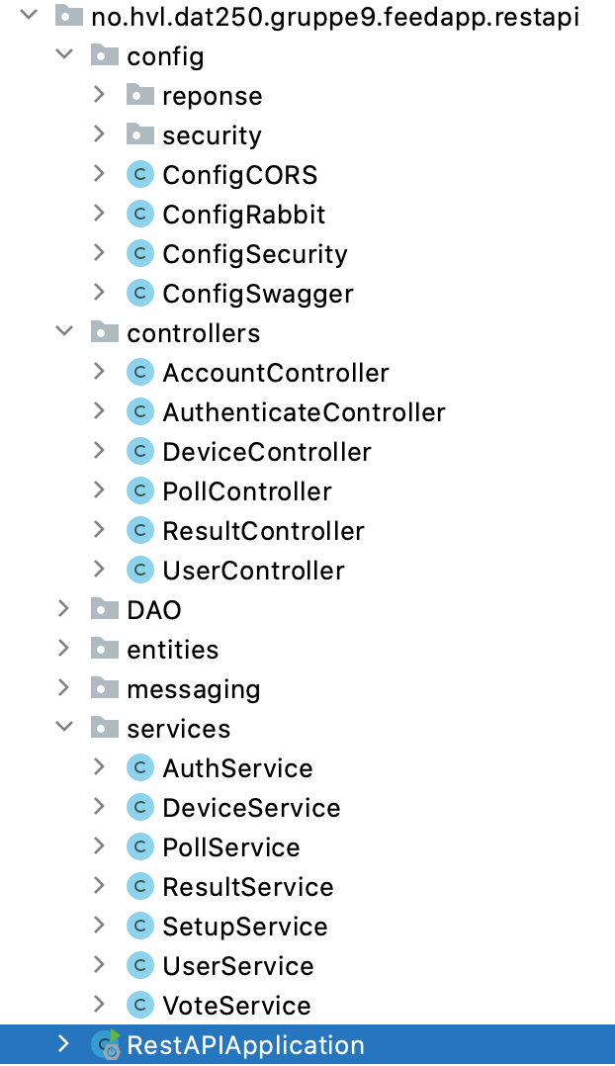
Overview of the backend in Spring
Controllers are thin, only what need to be there is there.
Logic is in “Services”, main logic of the operation.
DAO handles the storage/retrieving.

Slide 7
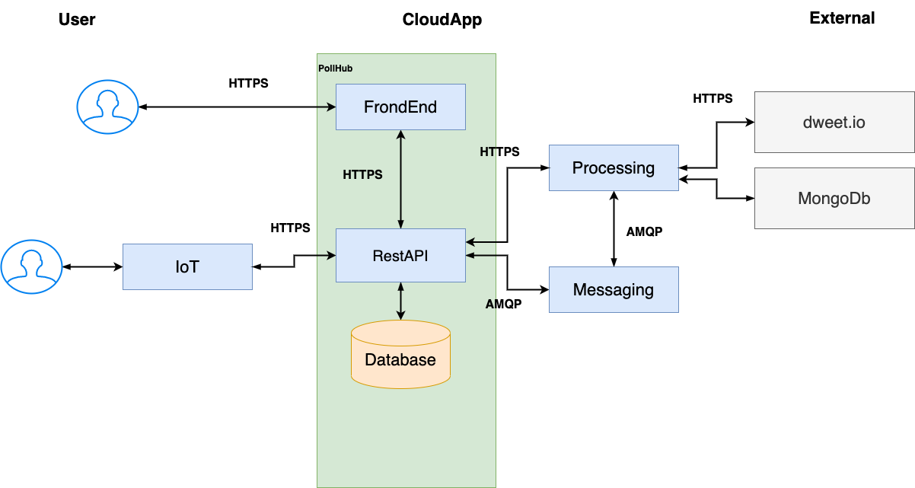

Overview of the backend in Spring

Slide 8

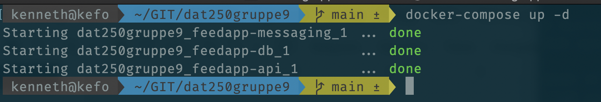
Docker for dev and deployment
Challenges
To run the API: - The team had to install (MySQL on their machines) - Later it became clear, they needed RabbitMQ also - Also Microservice is in Rust, they need Rust Tools - also need Maven/Java and so forth…
List is endless.

Slide 9
Docker for dev and deployment
We dockerized the API and pulled the mysql:latest.
No, all they need to do is write the following command:
And the FrontEnd developer don’t have to install anything (except docker)

Slide 10
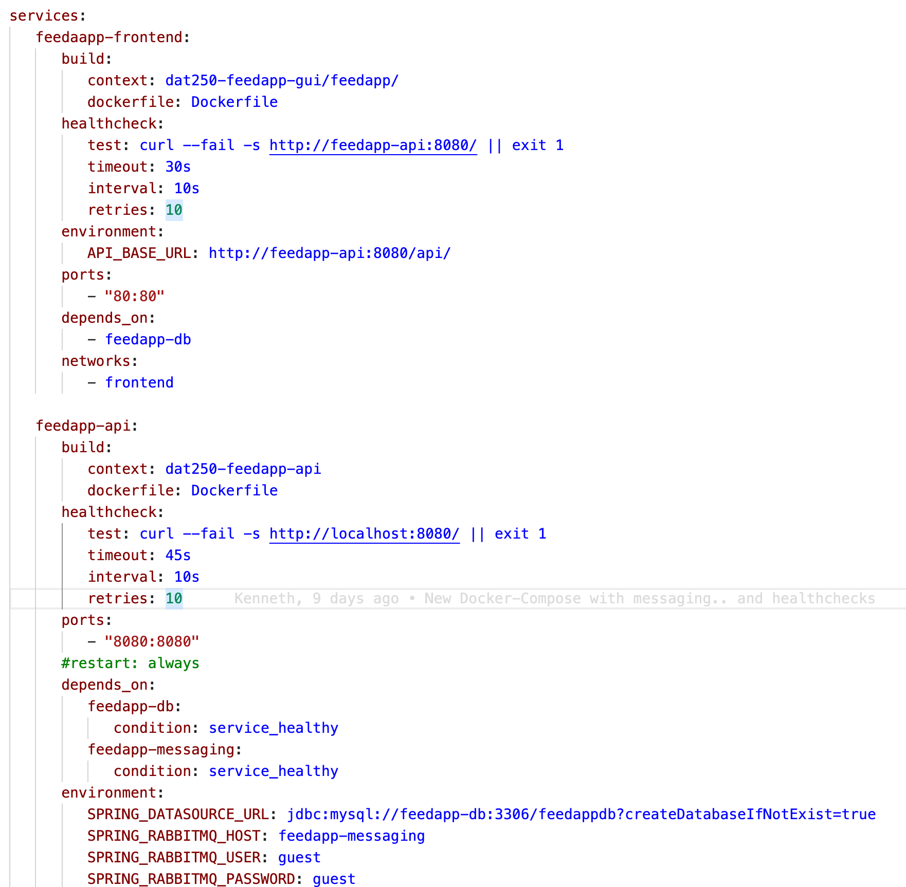
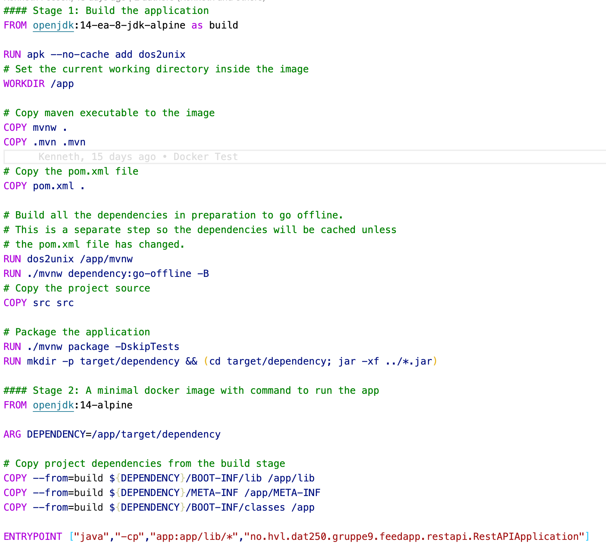
Docker for dev and deployment
Dockerfile / docker-compose.yml

Slide 11
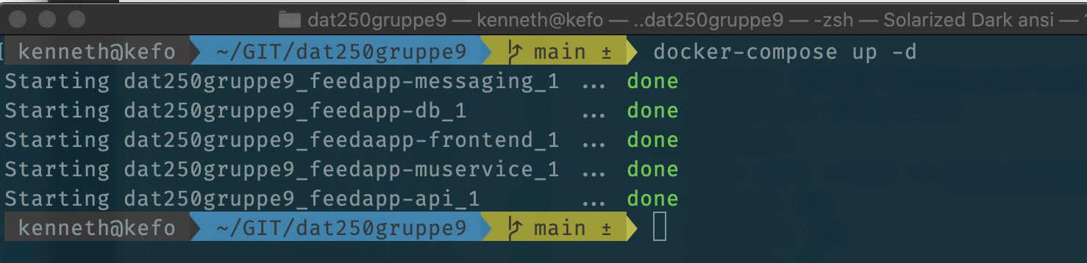
Docker for dev and deployment
Benefits: - everyone in the group had same version of the software. - no need to install. - windows/mac/linux they all write the same command - free to choose tech in the stack

Slide 12









TechStack Overview
FrontEnd
Backend
IoT
App
Hw
Db/Msg
Cloud

Slide 13
Project
Andrè Frøseth Jønland
Jan-Erik Erstad
Kenneth Fossen
Rune Almåsbakk
spydx/dat250gruppe9: Gruppe oppgave for DAT250

